Slide 1

Web Service-SOAP
SUDHIR M– Crew Pay
KRISHNA SINGHA –Crew Pay
Date ( Nov 16, 2016)

Slide 2

Agenda
Introduction to Web Service
WSDL
Soap Request - Response
Publish SOAP Web Service
SOAP UI

Slide 3
What is Web Service?
Web service is a way of communication that allows interoperability between different applications on different platforms, for example, a java based application on Windows can communicate with a .NET based one on Linux. The communication can be done through a set of XML messages over HTTP protocol.
According to W3C, “Web Services are the message-based design frequently found on the Web and in enterprise software. The Web of Services is based on technologies such as HTTP, XML, SOAP, WSDL, SPARQL, and others.”

Slide 4
Characteristics Of Web Services:
Usability :
Web Services allow the business logic of many different systems to be exposed over the Web. This gives our applications the freedom to chose the Web Services that they need. Instead of re-inventing the wheel for each client, we need only include additional application-specific business logic on the client-side. This allows you to develop services and/or client-side code using the languages and tools that you want.
Interoperability :
This is the most important benefit of Web Services. Web Services typically work outside of private networks, offering developers a non-proprietary route to their solutions. Web Services also let developers use their preferred programming languages. In addition, thanks to the use of standards-based communications methods, Web Services are virtually platform-independent.

Slide 5
Characteristics Of Web Services:
Loosely Coupled:
Each service exists independently of the other services that make up the application. Individual pieces of the application to be modified without impacting unrelated areas.
Ease of Integration:
Data is isolated between applications creating ’silos’. Web Services act as glue between these and enable easier communications within and across organizations.
Deployability :
Web Services are deployed over standard Internet technologies. This makes it possible to deploy Web Services even over the fire wall to servers running on the Internet on the other side of the globe. Also thanks to the use of proven community standards, underlying security (such as SSL) is already built-in.

Slide 6
Web Service Architecture:

Slide 7
Types Of Web Services:
SOAP: SOAP stands for Simple Object Access Protocol. SOAP is an XML based industry standard protocol for designing and developing web services. Since it’s XML based, it’s platform and language independent. So our server can be based on JAVA
and client can be on .NET, PHP etc. and vice versa.
REST: REST is an architectural style for developing web services. It’s getting popularity recently because it has small learning curve when compared to SOAP. Resources are core concepts of Restful web services and they are uniquely identified by their URIs.

Slide 8
Java Web Services API:
Java provides it’s own API to create both SOAP as well as REST web services.
JAX-WS: JAX-WS stands for Java API for XML Web Services. JAX-WS is XML based Java API to build web services server and client application.
JAX-RS: Java API for RESTful Web Services (JAX-RS) is the Java API for creating REST web services. JAX-RS uses annotations to simplify the development and deployment of web services.
Both of these APIs are part of standard JDK installation, so we don’t need to add any jars to work with them. Both of these APIs use annotations.

Slide 9
Web Service Description Language(WSDL):
WSDL stands for Web Service Description Language. It is an XML file that describes the technical details of how to implement a web service, more specifically the URI, port, method names, arguments, and data types. Since WSDL is XML, it is both human-readable and machine-consumable, which aids in the ability to call and bind to services dynamically.
Universal Description, Discovery and Integration(UDDI):
UDDI stands for Universal Description, Discovery and Integration. It is a directory service. Web services can register with a UDDI and make themselves available through it for discovery.

Slide 10
Elements Of WSDL:
Description: It is the root element of a WSDL file. It usually contains a set of name space declarations which are used throughout the WSDL file. Types: The WSDL types element describes the data types used by your web service. Data types are usually specified by XML schema. It can be described in any language as long as your web services API supports it. Binding: The WSDL binding element describes how your web service is bound to a protocol. In other words, how your web service is accessible. To be accessible, the web service must be reachable using some network protocol. This is called "binding" the web service to the protocol.

Slide 11
Interface: The WSDL interface element describes the operations supported by your web service. It is similar to methods in programming language. Client can only call one operation per request.
Service: It describes the endpoint of your web service. In other words, the address where the web service can be reached.
Endpoint: The endpoint element describes the address of the web service. The endpoint binding attribute describes what binding element this endpoint uses i.e. protocol with which you will access web service. The address attribute describes the URI at which you can access the service.
Message: The message element describes the data being exchanged between the Web service providers and consumers.

Slide 12
WSDL Internal References
WSDL
Document
[Types]
A WSDL document describes
What the service can do
Where it resides
How to invoke it
{Messages}
{PortTypes}
{Bindings}
{Services}

Slide 13
SOAP-Simple Object Access Protocol
SOAP is just a message format.
Must transport with HTTP, TCP, etc.
SOAP is independent of but can be connected to WSDL.
SOAP provides rules for processing the message as it passes through multiple steps.
SOAP payloads
SOAP carries arbitrary XML payloads as a body.
SOAP headers contain any additional information.
These are encoded using optional conventions.

Slide 14
SOAP 1.1
XML based protocol for exchange of information
Encoding rules for datatype instances
Convention for representing RPC invocations
Designed for loosely-coupled distributed computing
Used with XML Schema
Transport independent
SOAP with Attachments allow arbitrary data to be packaged.
SOAP 1.1 Message Structure
SOAP
Envelope
Header
Entries
[Header
Element]
Body
Element
[Fault
Element]

Slide 15
SOAP Request
<soapenv:Envelope xmlns:soapenv="http://schemas.xmlsoap.org/soap/envelope/" xmlns:ws="http://ws.mahtabalam.net/">
<soapenv:Header/>
<soapenv:Body>
<ws:getCapital>
<state>Karnataka</state>
</ws:getCapital>
</soapenv:Body>
</soapenv:Envelope>

Slide 16
SOAP Response
<S:Envelope xmlns:S="http://schemas.xmlsoap.org/soap/envelope/">
<S:Body>
<ns2:getCapitalResponse xmlns:ns2="http://ws.mahtabalam.net/">
<city>Bengaluru</city>
</ns2:getCapitalResponse>
</S:Body>
</S:Envelope>

Slide 17
SOAP Schema
All of this is expressed formally in the SOAP schema.
Which in turn derives from the SOAP Infoset
XML on the right is taken directly from the SOAP schema.
This just encodes the previously stated rules.
Also, note that the SOAP envelope can contain other attributes.
<anyAttribute> tag is the wildcard
<xs:complexType name="Envelope">
<xs:sequence>
<xs:element ref="tns:Header" minOccurs="0" />
<xs:element ref="tns:Body" minOccurs="1" />
</xs:sequence>
</xs:complexType>

Slide 18
Soap Specification:
•A protocol binding provides a generic mechanism for sending a SOAP envelope via a lower level protocol such as HTTP.
•Encoding rules provide a convention for mapping various application data types into an XML tag-based representation.
•Finally, the RPC mechanism provides a way to represent remote procedure calls and their return values

Slide 19
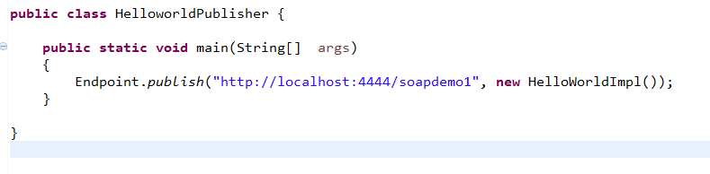
Publish SOAP WebService
Create a Dynamic Web Project and give the name to the project (Example: Soapdemo1).
Create a service implementation class HelloWorldImpl.java and annotate it with @WebService file.
Create a method and annotate it with @Webmethod.
Now publish the service using Endpoint.publish(url address, object implementor) as given in below example.

Slide 20
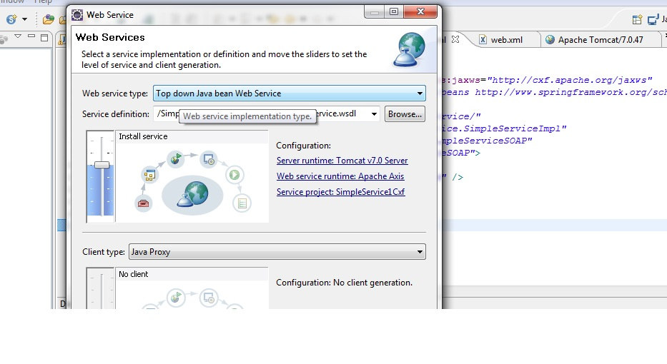
Another way to publish service without using Annotation is by using Apache Axis or cxf pluigin.
Axis or cxf plugin automatically generate wsdl from the given implementation class.

Slide 21
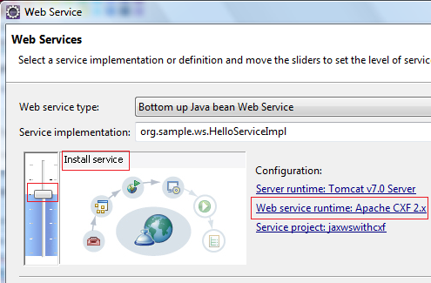
Click on OK button to close the Service Deployment Configuration dialog :

Slide 22
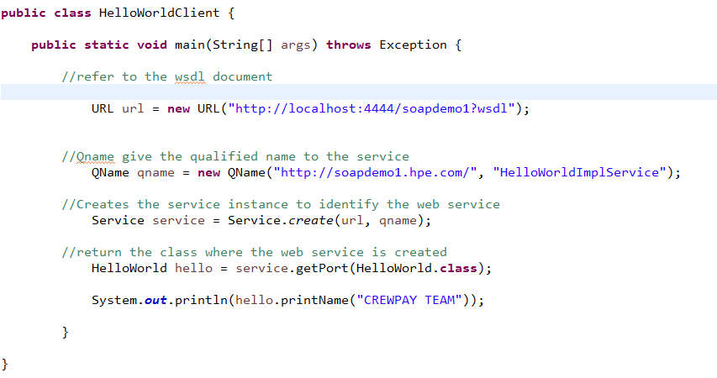
Consume SOAP service
Below code show the way to consume SOAP service.

Slide 23


Slide 24
Thank you

